Slide 1
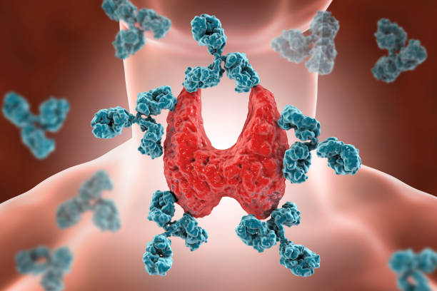
A Study of Hashimoto’s Thyroiditis
Hillory Suy, Ria Noble
Notes:
Ria

Slide 2
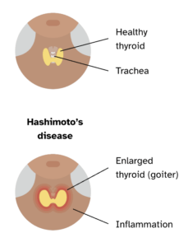
What is Hashimoto’s Thyroiditis?
Autoimmune disorder
Immune cells attack hormone-producing
thyroid cells
Decline in hormone production
Linked to:
Celiac Disease
Lupus
Rheumatoid Arthritis
Type 1 Diabetes
Notes:
Ria

Slide 3

Hashimoto’s Thyroiditis Symptoms:
Fatigue
Weight Gain
Trouble tolerating cold
Constipation
Dry skin, dry, thinning hair
Irregular periods, fertility problems
Miscarriage
Slowed heart rate
Treatment: Hormone treatment with levothyroxine (synthetic hormone)
Notes:
Ria

Slide 4
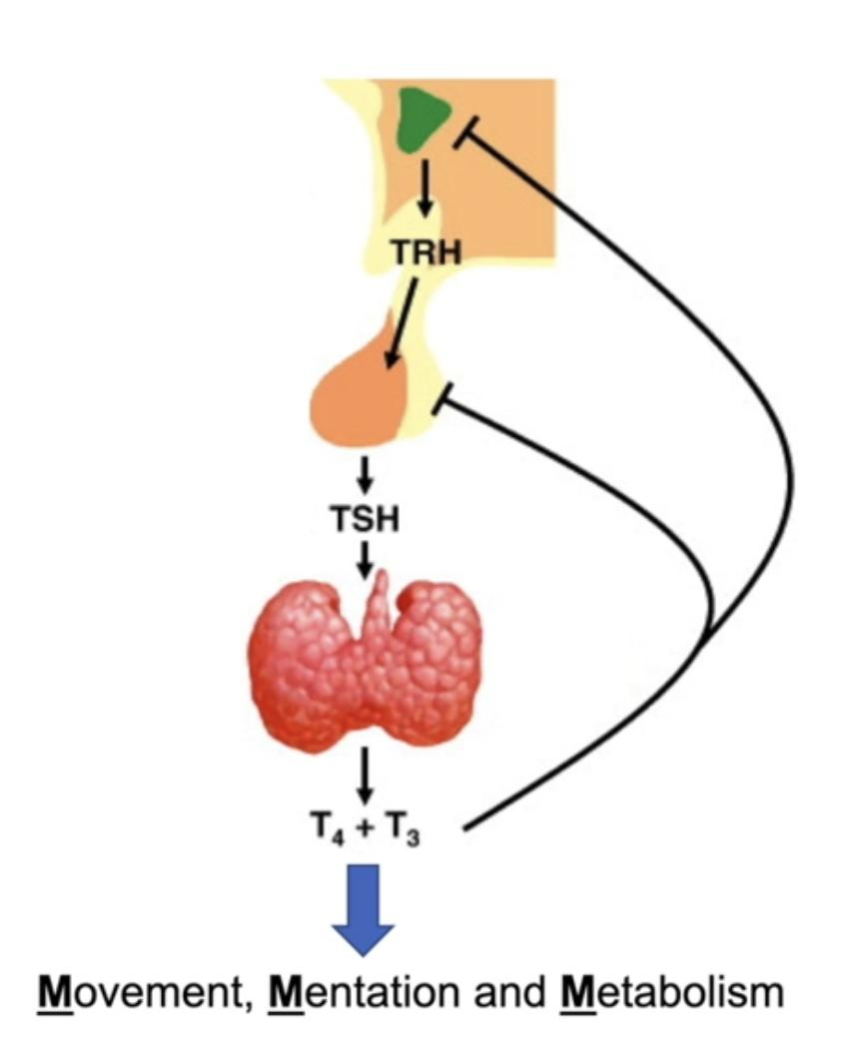
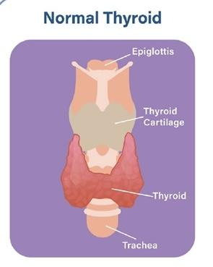
Healthy Thyroid
Notes:
Hillory

Slide 5
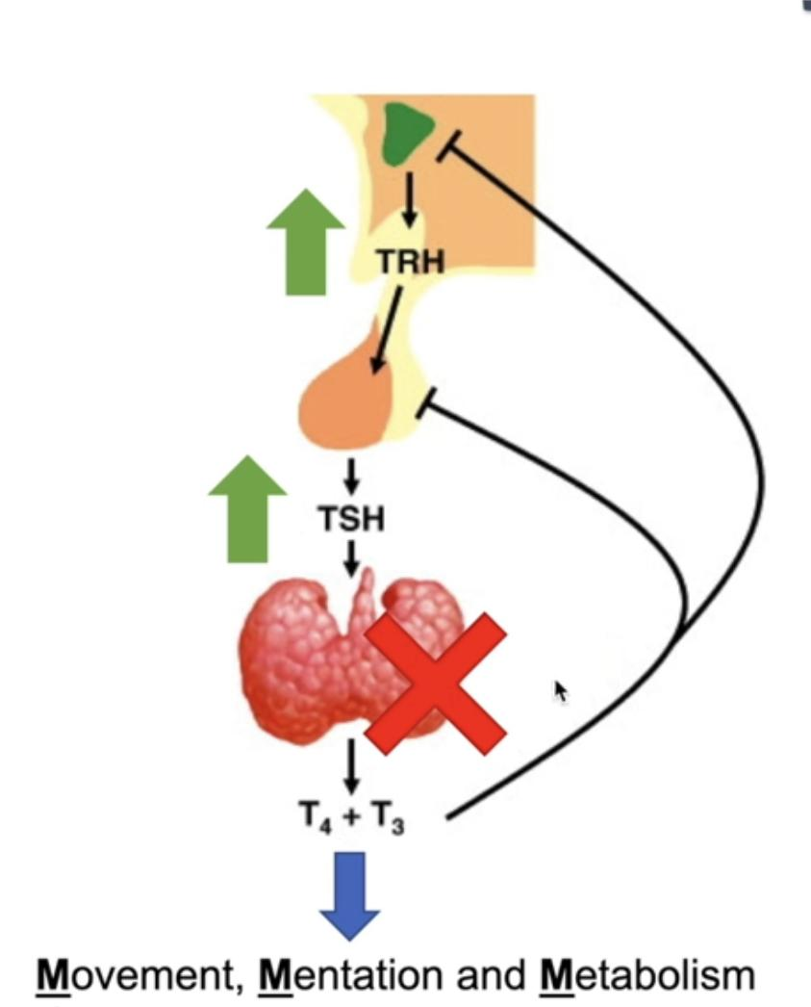
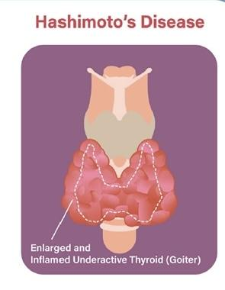
How Hashimoto’s Happens
B cells -> antibodies -> T cells attack thyroid
Reason not clear
Genetics
Environment
Notes:
Hillory

Slide 6
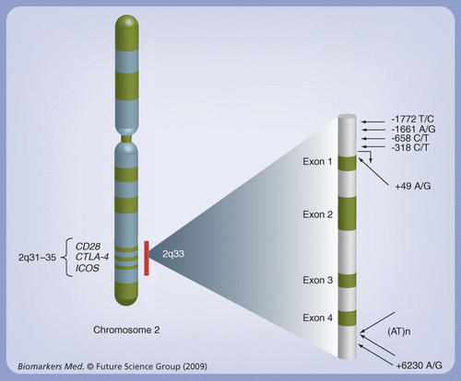
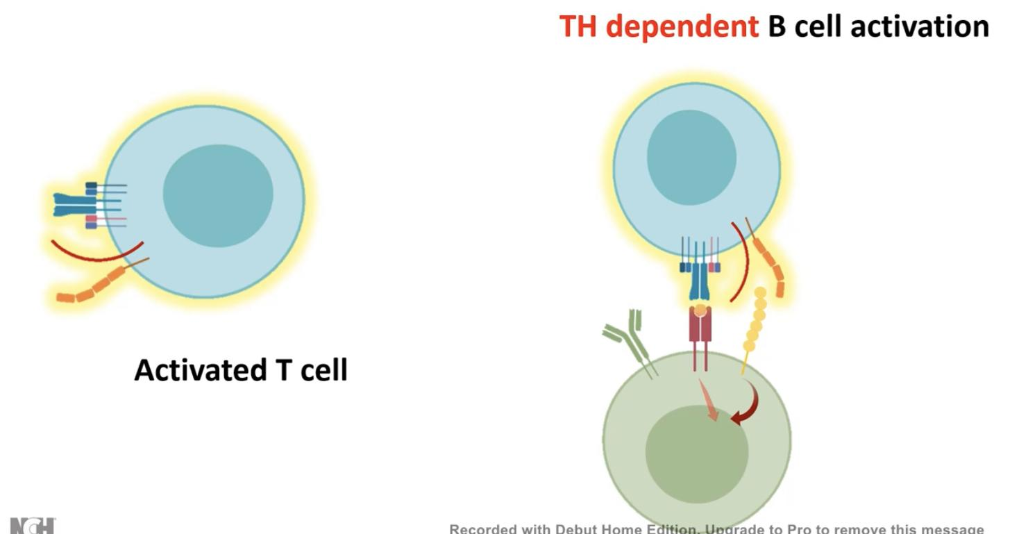
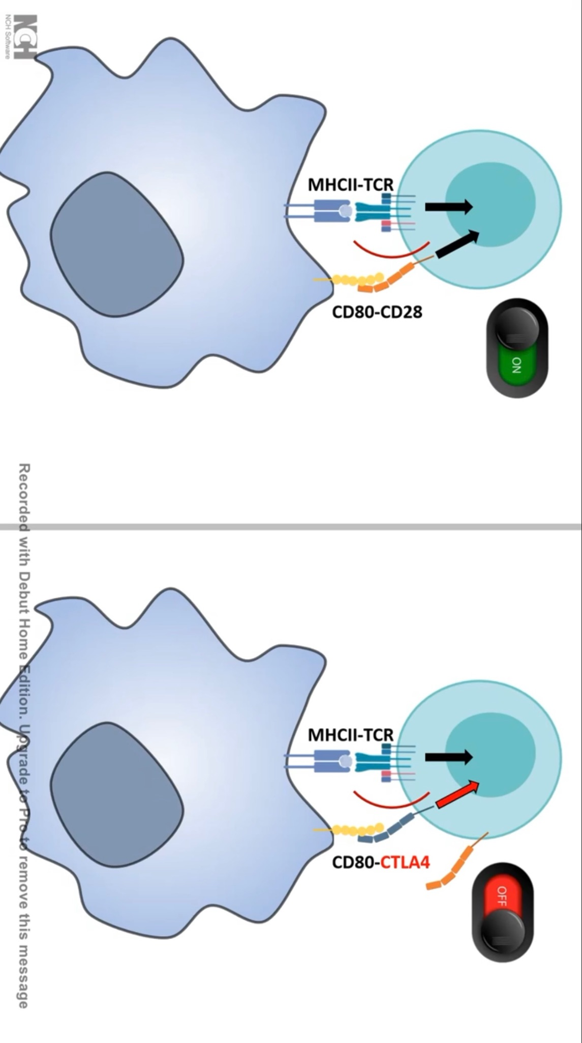
What is CTLA4?
CTLA4 located on chromosome 2 (2q33.2).
Codes for the CTLA4 receptor

Slide 7
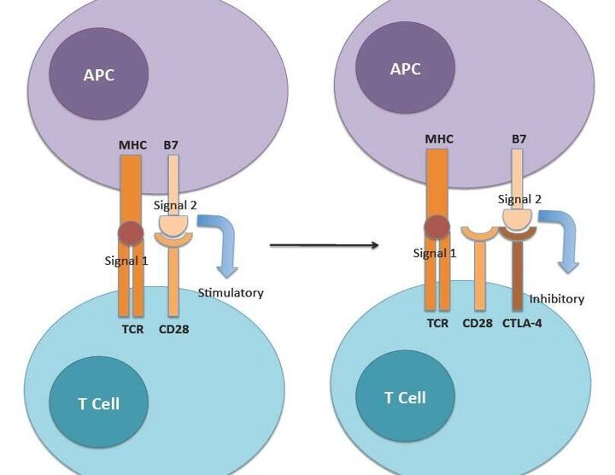
How CTLA4 inhibits T-cells

Slide 8
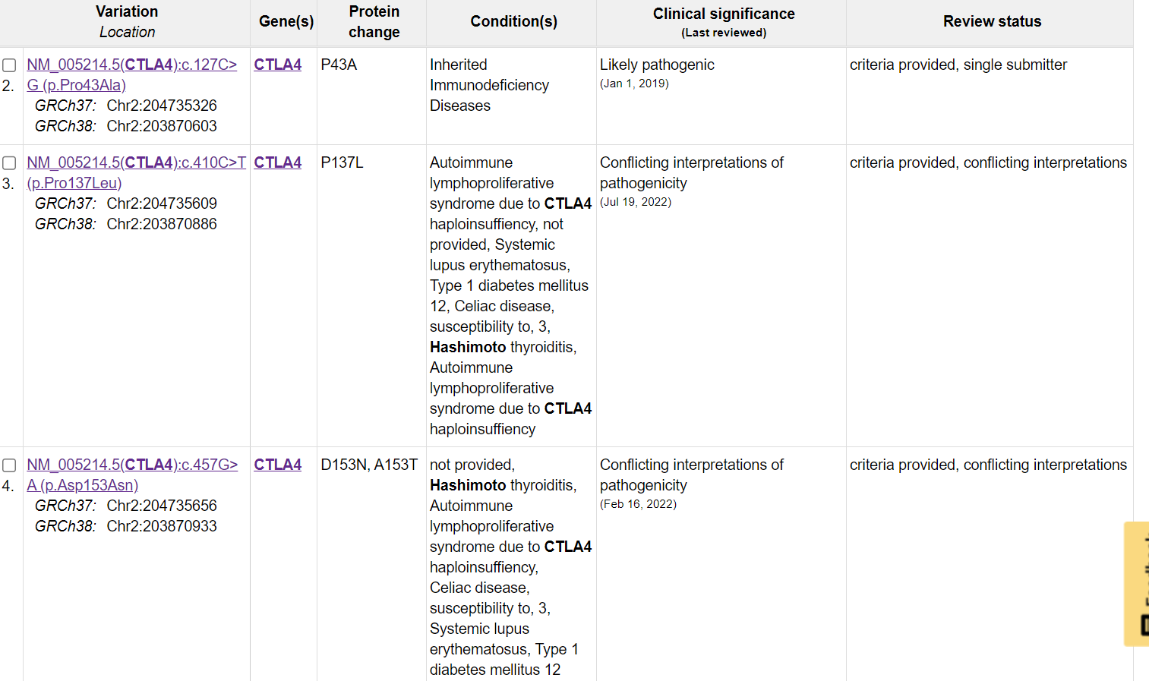

Slide 9
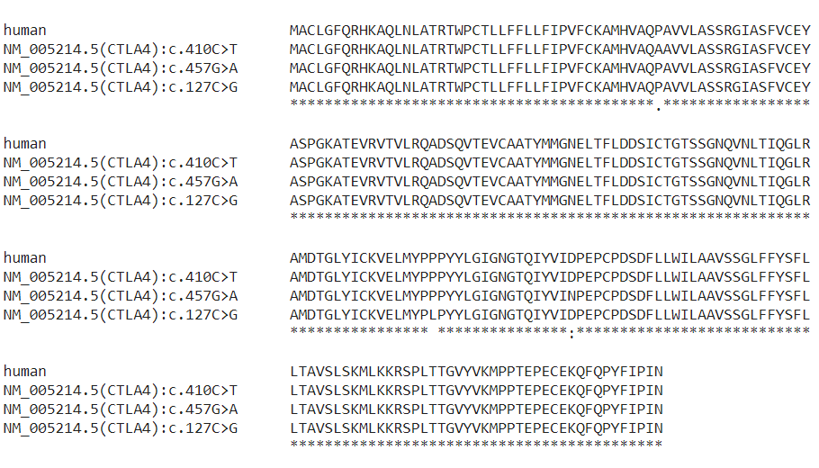
Notes:
Ria

Slide 10

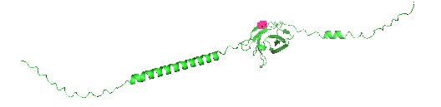

Notes:
Ria

Slide 11
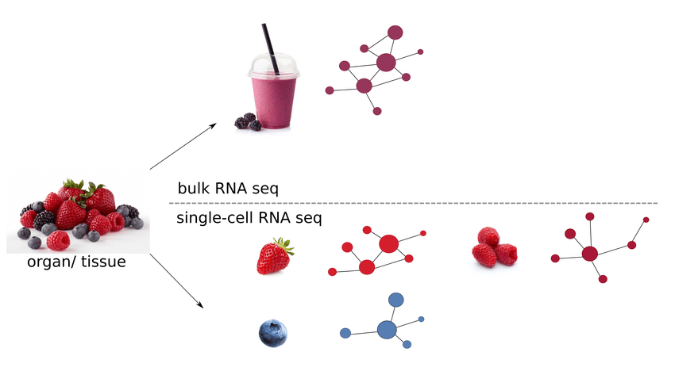
What is Single Cell Sequencing?
Gene expression levels in various cell types
More specific than bulk RNA seq (avg gene expressions measured across large range of cells)
More applications
Can rely on bulk sequencing analysis techniques

Slide 12
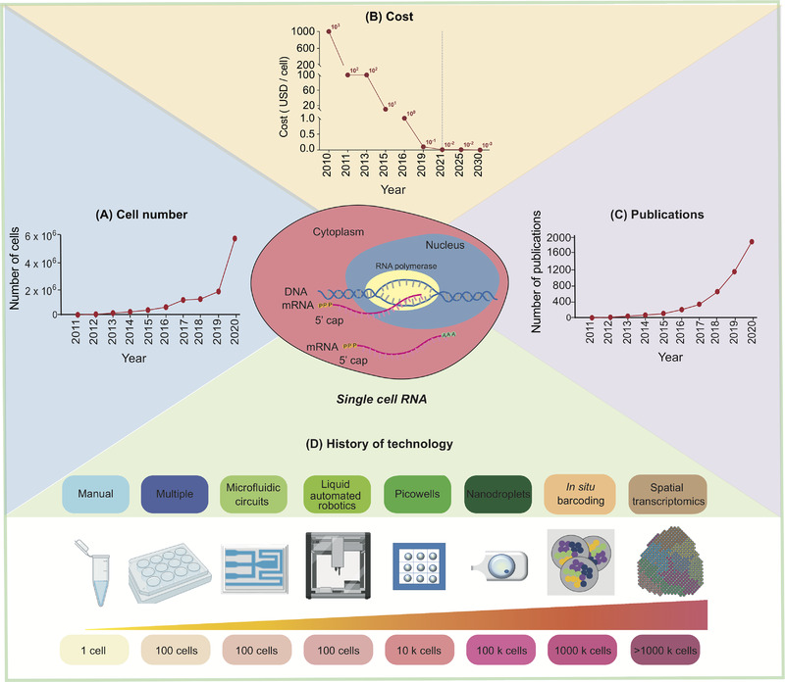

Slide 13

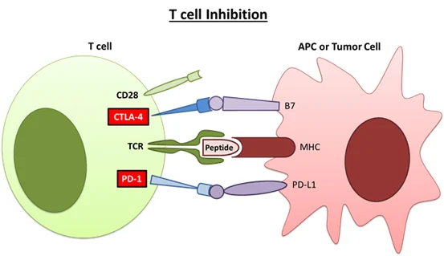
Immune Checkpoint Inhibitor (ICI)
ICI
Thyroid cell

Slide 14
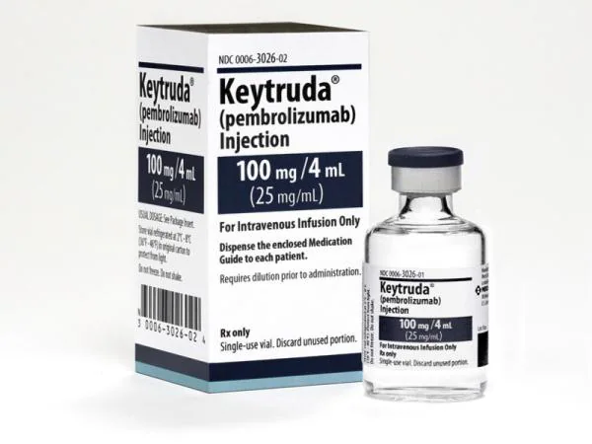
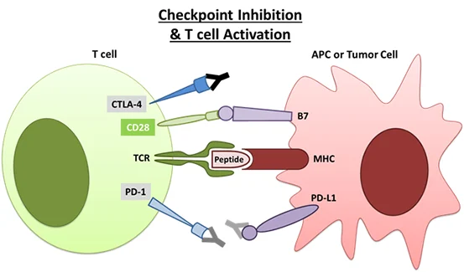
ICI drug (Treatment)
Thyroid or Tumor cell
Tumor cell or Thyroid cell

Slide 15
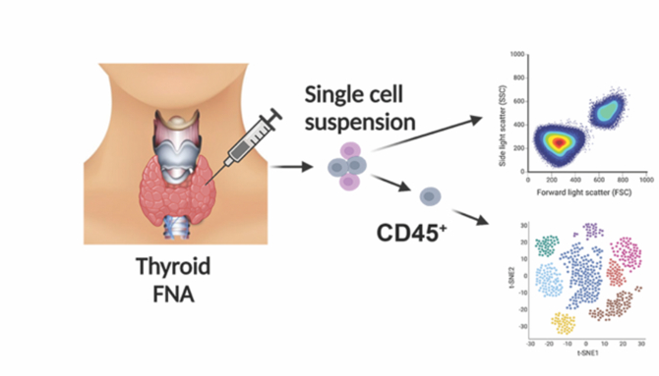
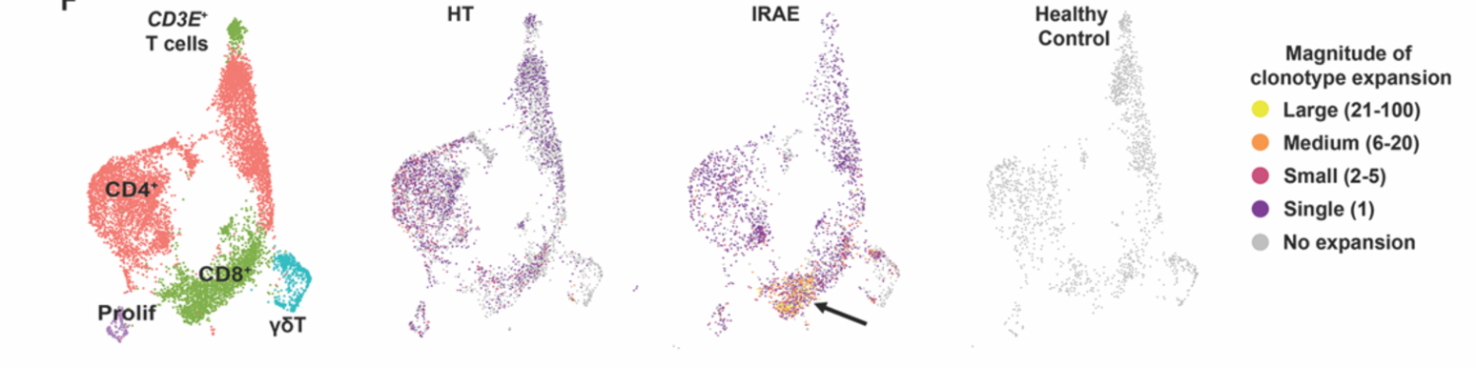
Single Cell Paper
Autoimmune toxicity occurs in up to 60% of ICI patients
ICI - Immune Checkpoint Inhibitors; given to cancer patients
Mediated toxicity (IRAE) patients compared to HT and healthy people
Identified specific group of T cells (CD8+) that are not active in other conditions
Testing with mouse model identified a solution
Genetic deletion of IL-21 pathway
Notes:
FNA - fine needle aspiration

Slide 16
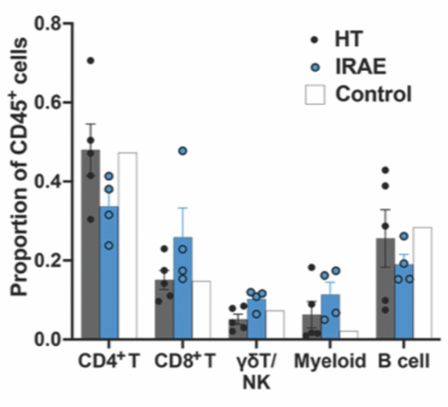
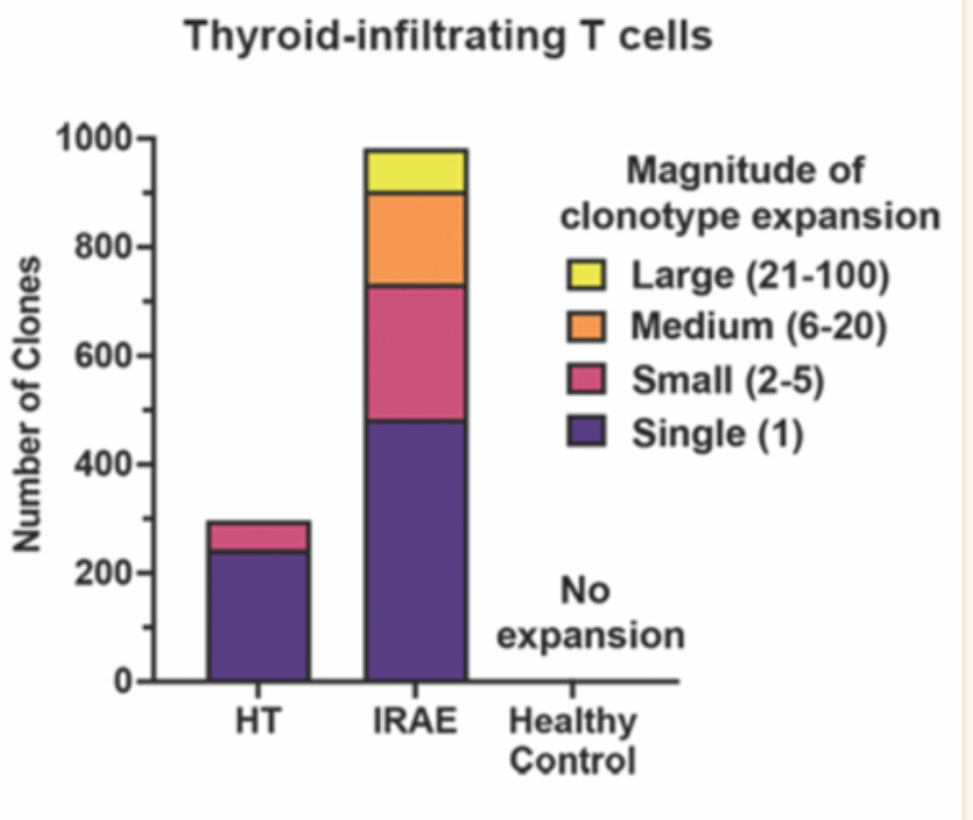
Differentially gene expressed pathway
CD8+ T cells are expanded in ICI-thyroiditis
compared to HT.

Slide 17
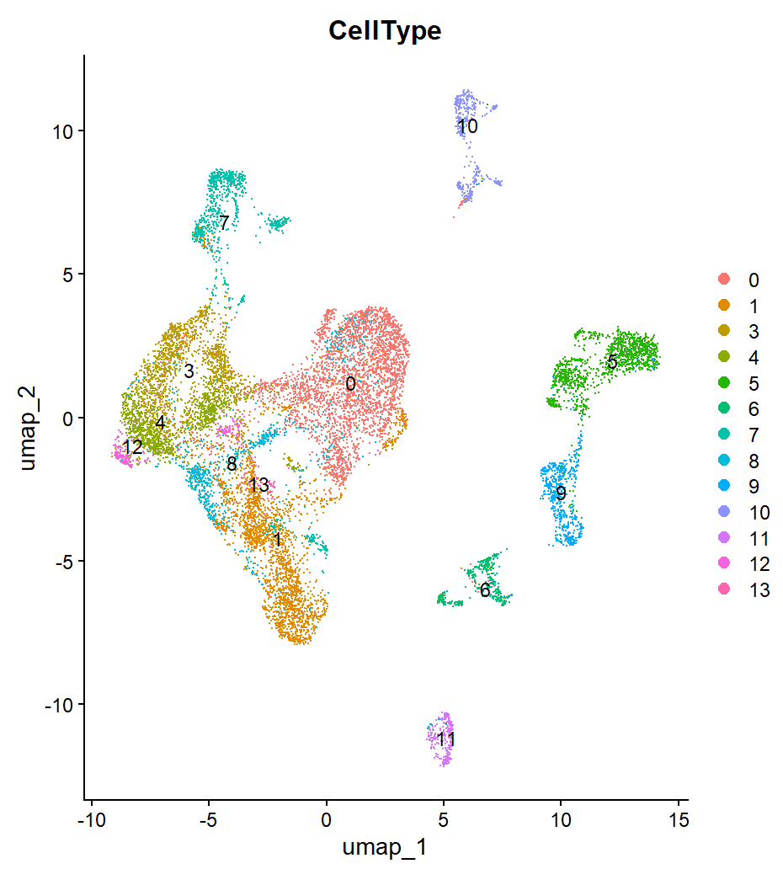
R Code

Slide 18
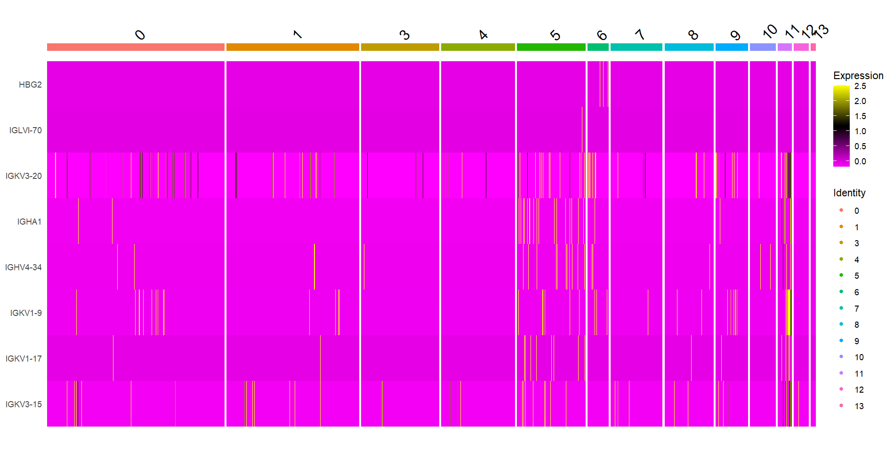

Slide 19
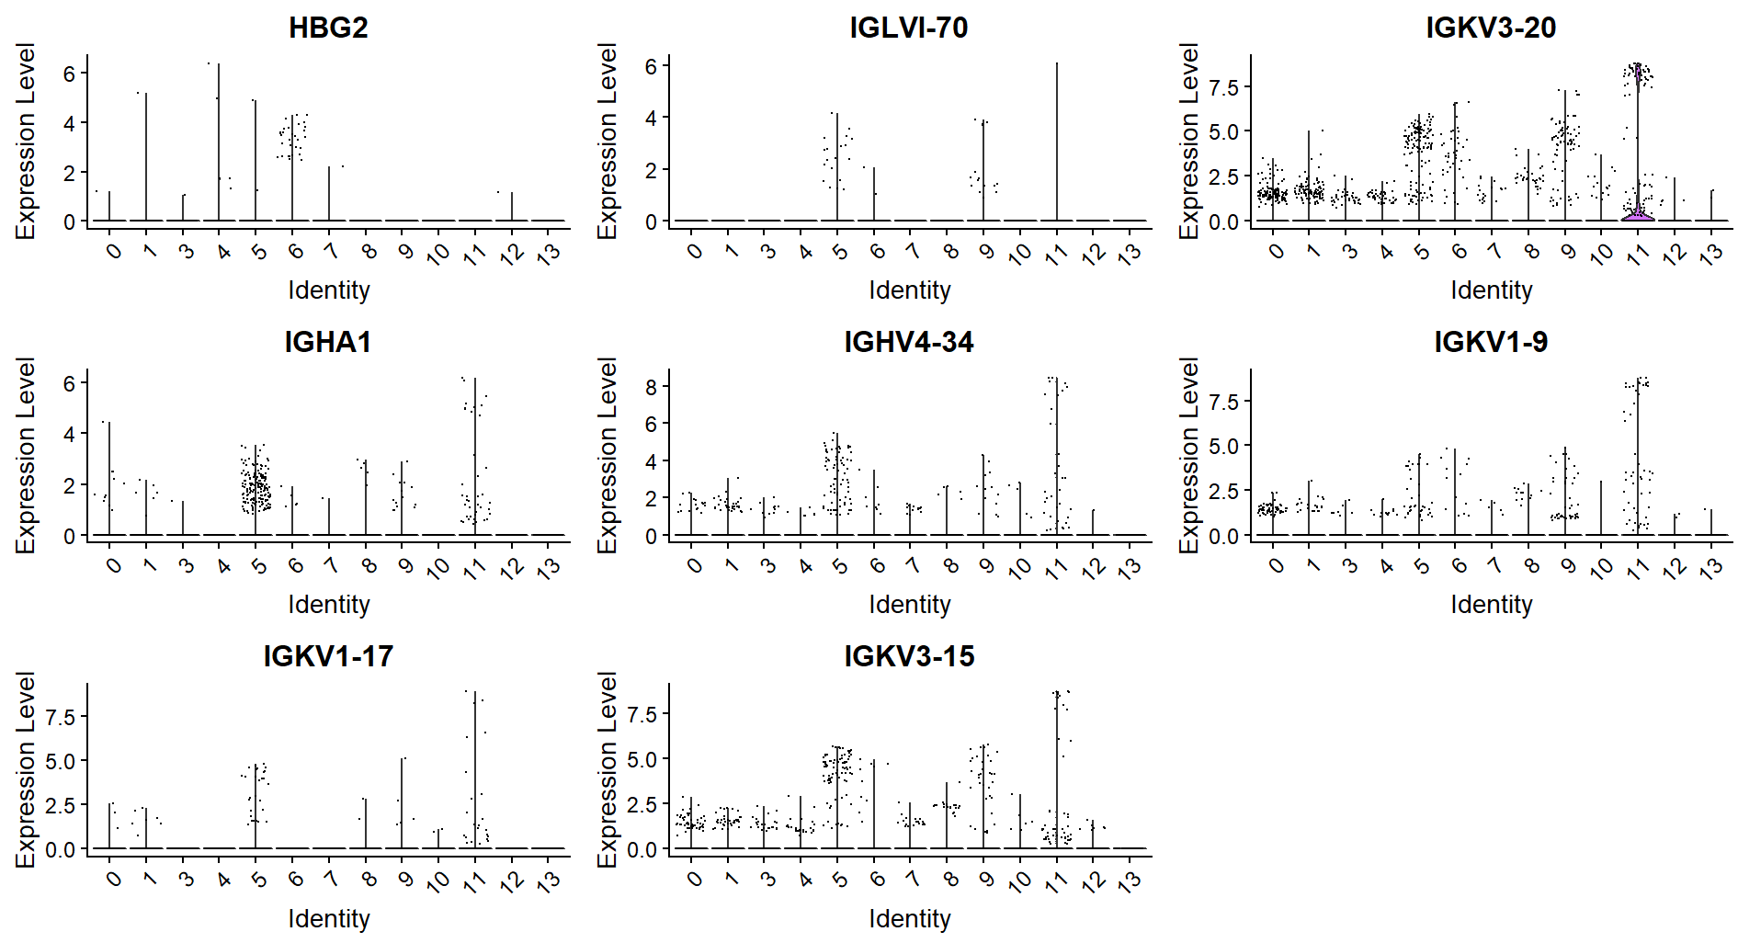

Slide 20
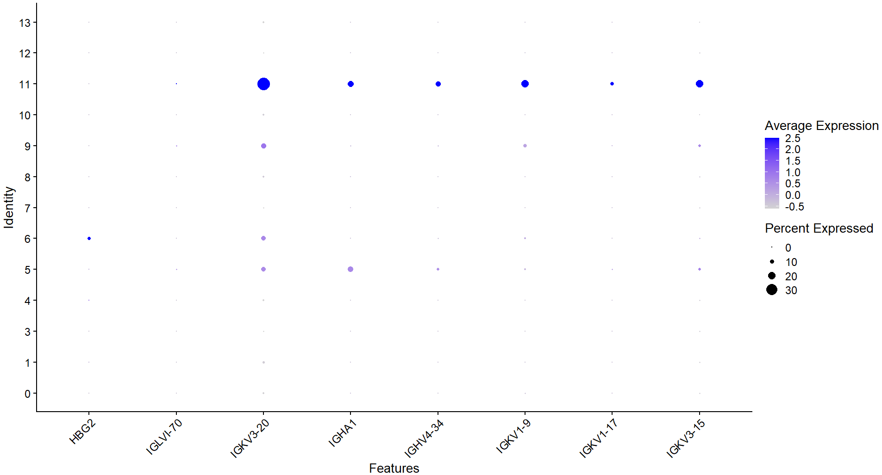

Slide 21
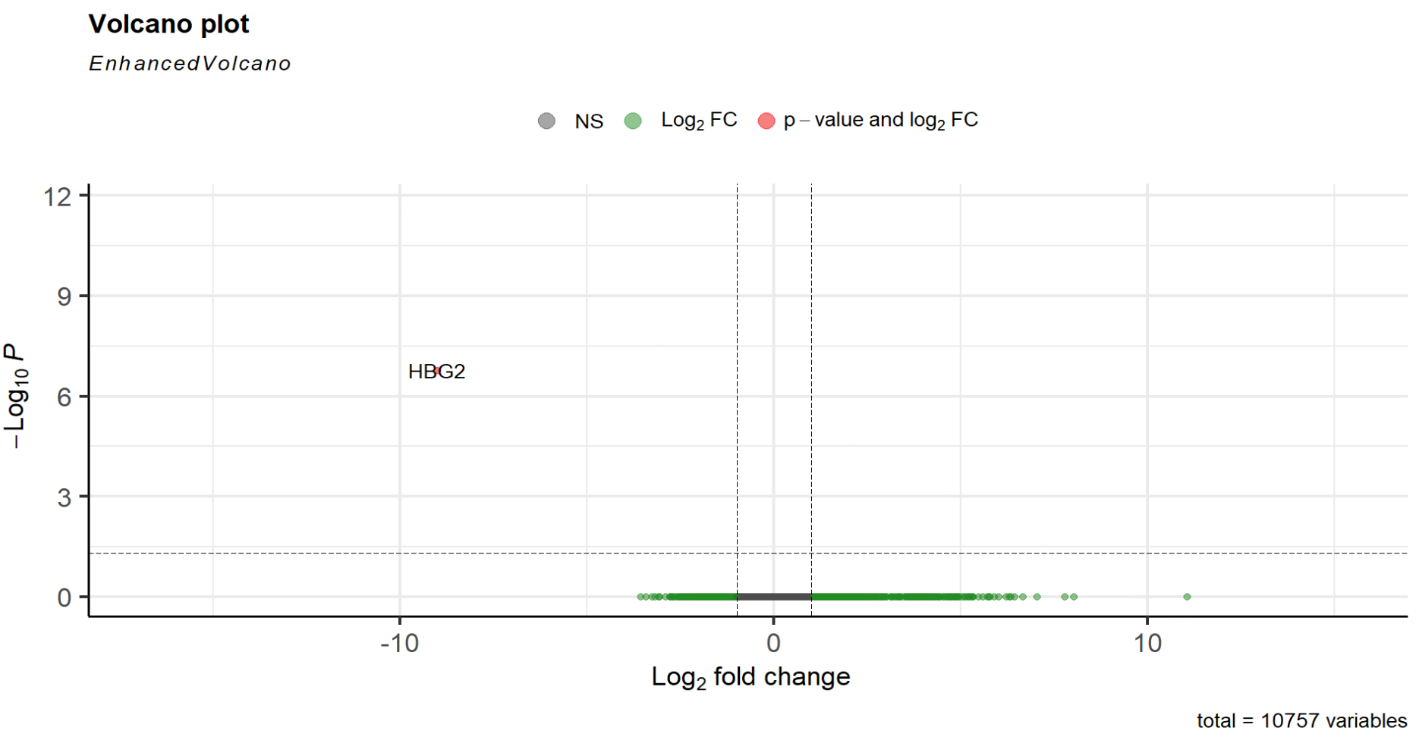
Cell Type g4

Slide 22
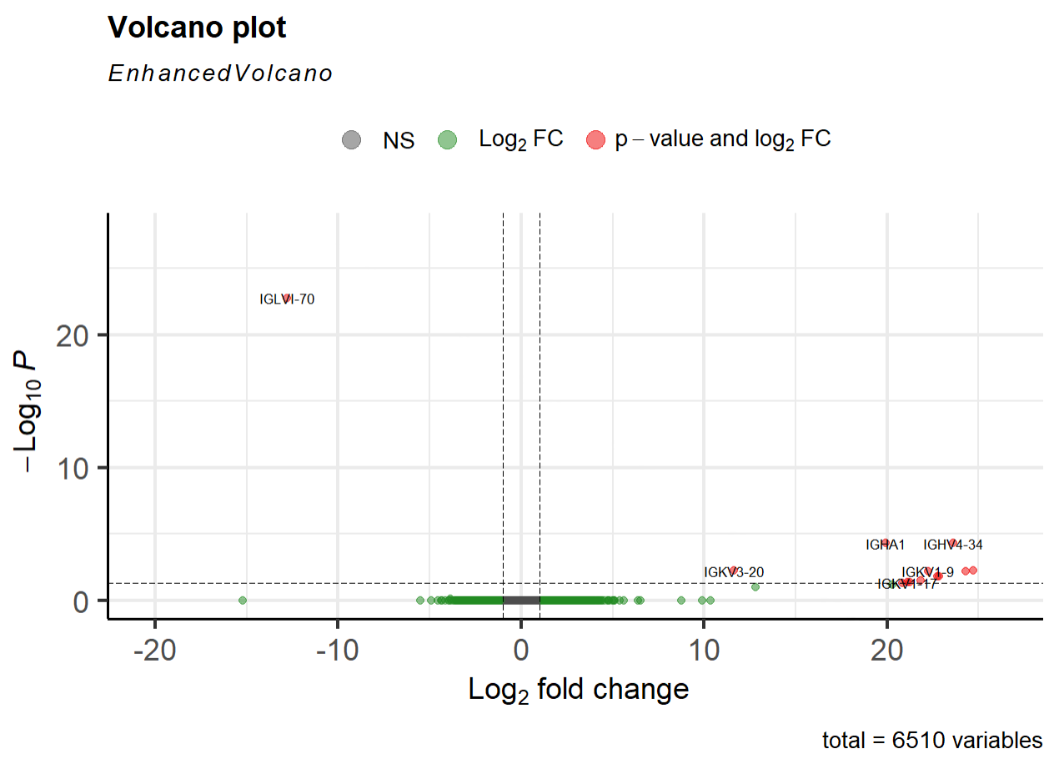

Slide 23
Interpretation - What does this mean for Hashimoto’s?
HBG2, IGLVI-70, IGKV3-70, IGHA1, IGHV4-34, IGKV1-9, IGKV1-17, IGKV1-15
Cell type 11 is B cells?
Majority of genes related to antibodies
Overexpression of antibodies -> more attacking of thyroid

Slide 24
Any Questions?
Notes:
T cell IL-21 signaling drives ICI-associated thyroid autoimmunity.
Based upon our human scRNAseq and mouse data, we predicted that IL-21 action on T cells was a primary driver of ICI-thyroiditis. However, IL-21 is a pleiotropic cytokine with action on multiple immune populations. IL-21 targets CD4+ T cells to promote the further differentiation of IL-21+ producing Tfh and Tph cells, as well as IL-17+ producing T helper cells (Th17). Both Tfh/Tph and Th17 T cells have been associated with spontaneous autoimmune disease, and more recently IRAEs (9, 23, 24). In CD8+ T cells, IL-21 also enhanced cytotoxicity and effector function. In addition to its actions on T cells, IL-21 plays an important role in B cell proliferation and antibody production and class switching (33, 35); it can also enhance phagocytosis by macrophages (47).

Slide 25
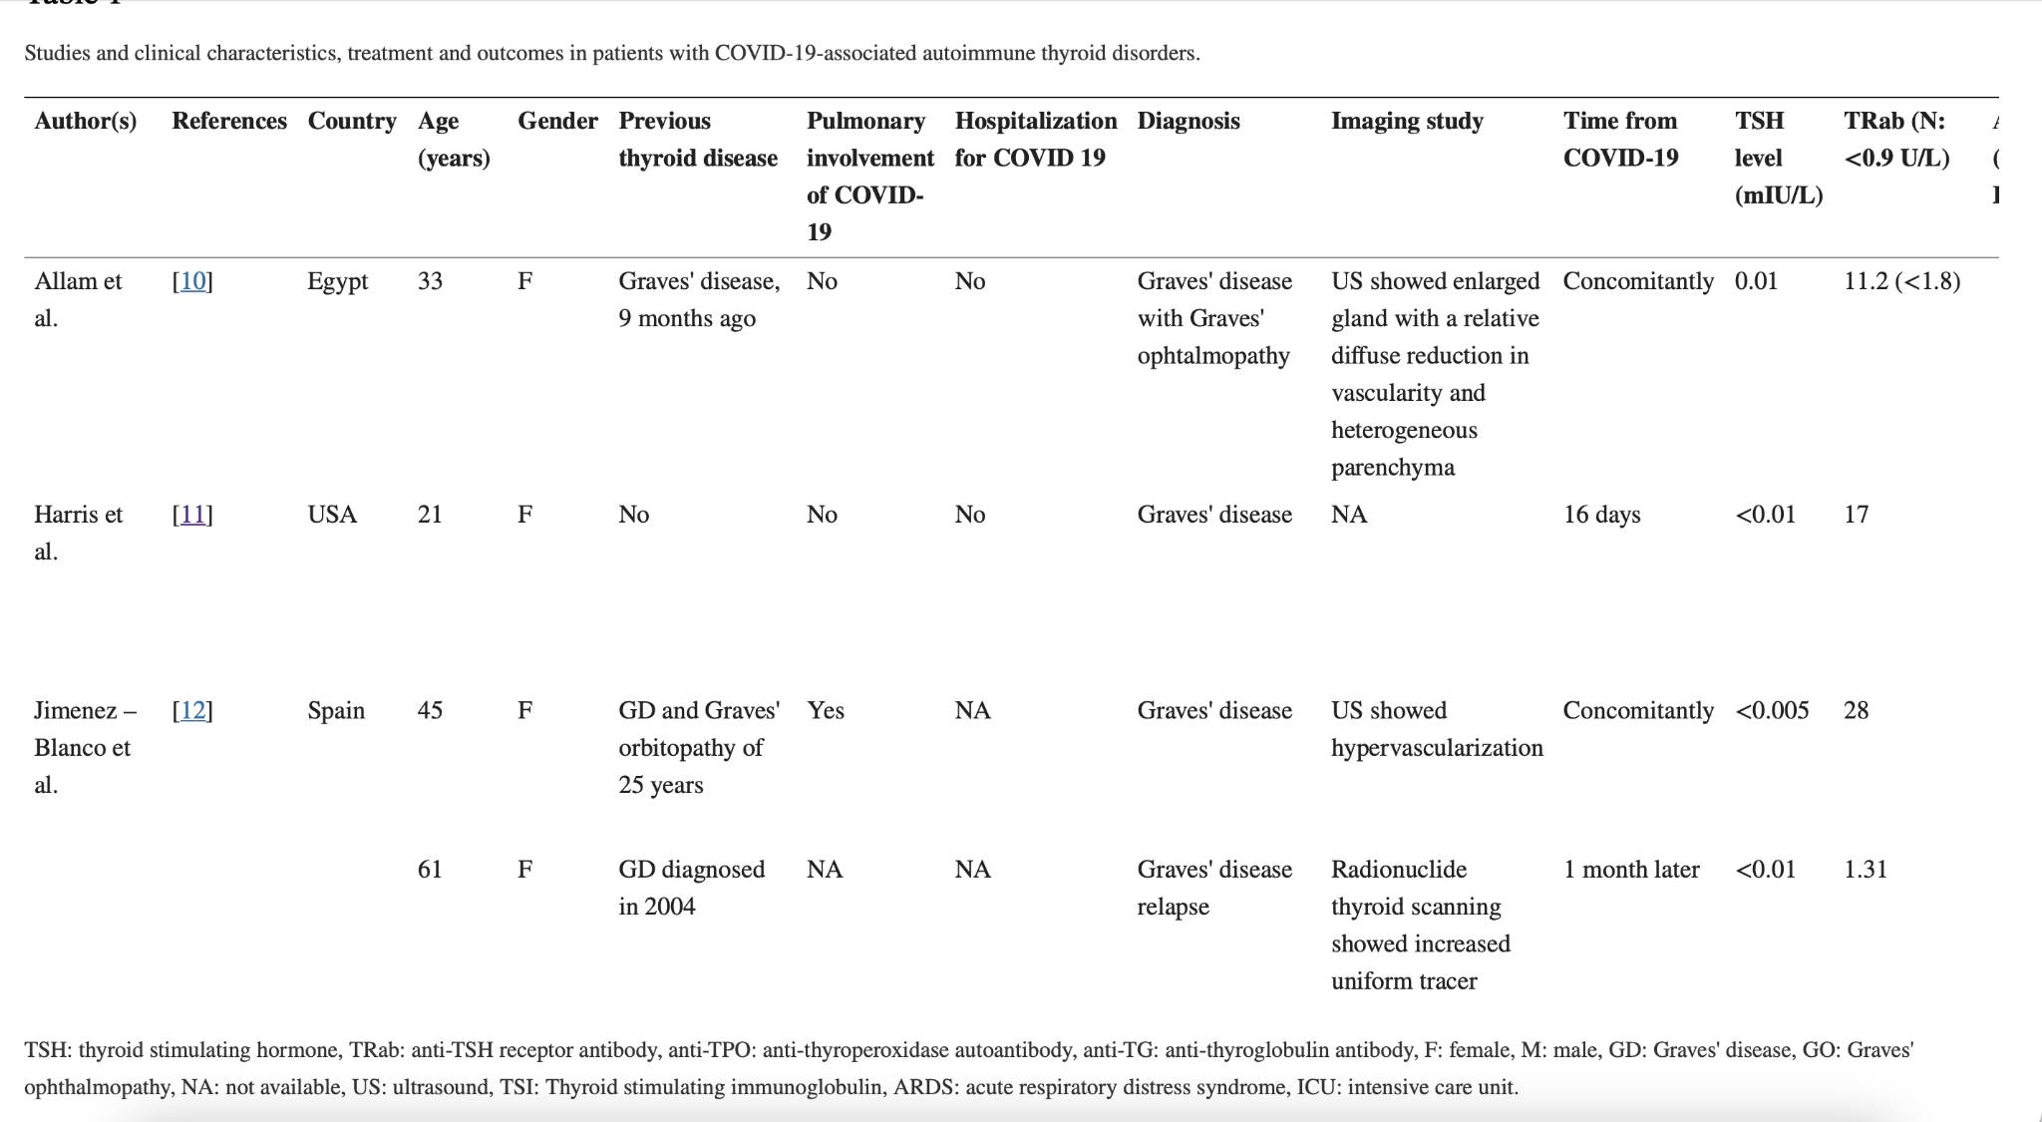
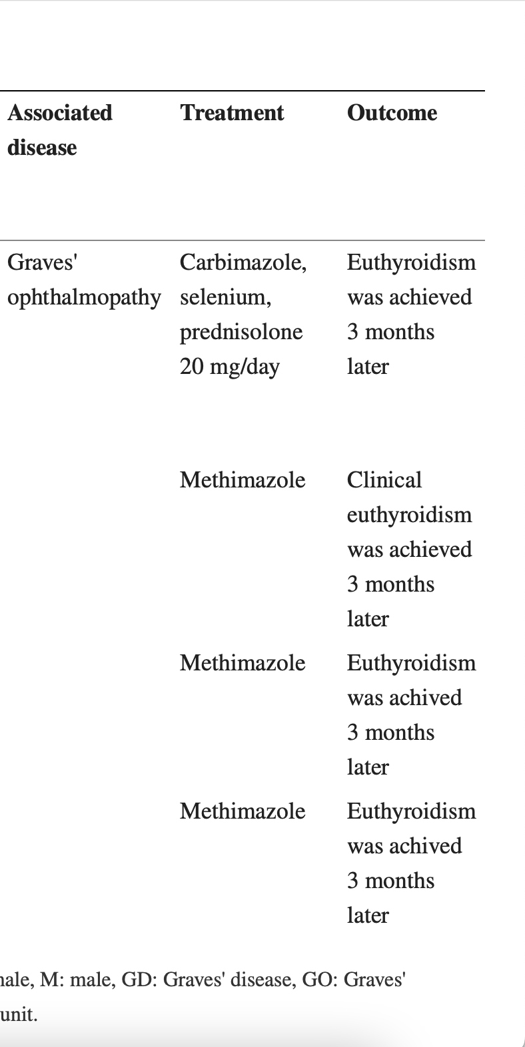
COVID

Slide 26
Covid
The majority (16/20, 80%) were middle-aged (mean age: 40 years) female patients.
Autoimmune thyroiditis was diagnosed either concomitantly or 7–90 days after the COVID-19 infection.
Eight out of 14 cases with Graves' disease had a known thyroid disorder and they were stable in remission
Among patients with Hashimoto's thyroiditis, only one of the cases had known prior hypothyroidism [21]. A 69-year-old woman with small cell lung cancer has been reported to develop myxedema coma precipitated by COVID-19. She was presented with hypothermia, hypotension, and hypoventilation with a Glasgow Coma score of 5. A diagnosis of myxedema coma was made with increased TSH (61.3 mIU/L) and decreased fT4 (0.2 ng/dL) levels. The patient died on the third day of hospital admission. Decompensated hypothyroidism precipitated COVID-19 in this patient was attributed to preexisting immunotherapy induced autoimmune thyroiditis. Two patients with mild hypothyroidism (TSH <10 mIU/L) were reported while three had profound hypothyroidism [11,18,21]. In addition, anti-TPO antibody and anti-TG antibody levels were detected positive. Thyroid ultrasound showed heterogeneous and hypoechoic glands consistent with thyroiditis. All patients were treated with levothyroxine.

Slide 27
Multiple Sequence Alignment
https://www.ebi.ac.uk/Tools/services/web/toolresult.ebi?jobId=clustalo-I20231017-163521-0843-98199336-p1m&analysis=alignments <- Clustal Omega
https://www.ebi.ac.uk/Tools/services/web/toolresult.ebi?jobId=mafft-I20231017-163542-0637-43017433-p1m <- MAFFT (in slide)
https://www.ebi.ac.uk/Tools/services/web/toolresult.ebi?jobId=muscle-I20231017-163548-0086-77617350-p1m <- MUSCLE

Slide 28
Nucleotide and Protein Sequences
https://www.ncbi.nlm.nih.gov/protein/NP_005205.2?report=fasta
https://www.ncbi.nlm.nih.gov/nuccore/NG_011502.1?from=4986&to=11180&report=fasta
SNPs: rs1491445812
https://www.ncbi.nlm.nih.gov/nuccore/NC_000002.12?report=fasta&from=203867771&to=203873965
A49G and CT60 are variants linked to HT gene

Slide 29
Why We Chose CTLA4
Potential articles:
https://www.ncbi.nlm.nih.gov/gene/1493
https://pubmed.ncbi.nlm.nih.gov/32185705/
https://pubmed.ncbi.nlm.nih.gov/30326243/
https://www.ncbi.nlm.nih.gov/pmc/articles/PMC10227862/
Variant Search:
https://www.ncbi.nlm.nih.gov/clinvar/?term=ctla4%5Bgene%5D+hashimot

Slide 30
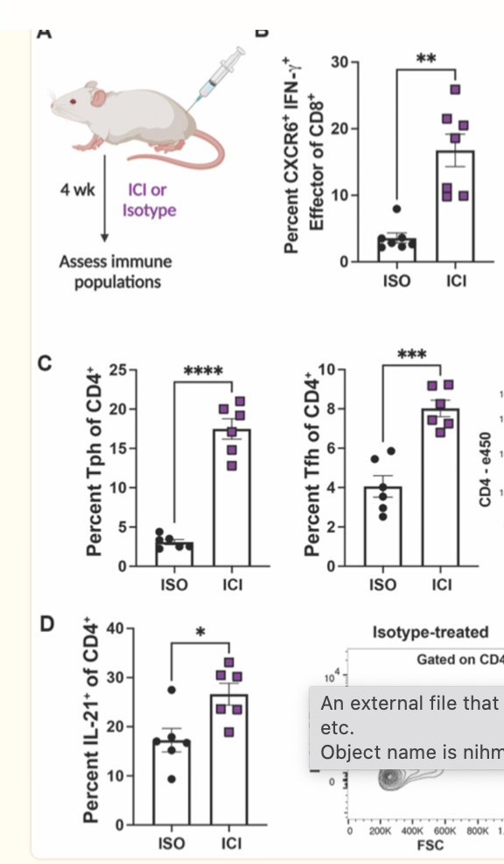
ICI treatment in an IRAE mouse model

Slide 31
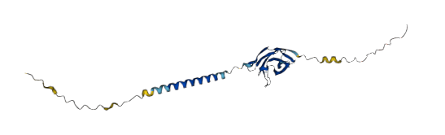
Healthy CTLA4 Sequence
Potential Functional Region
Potential Transmembrane Regions
Notes:
Ria

Slide 32
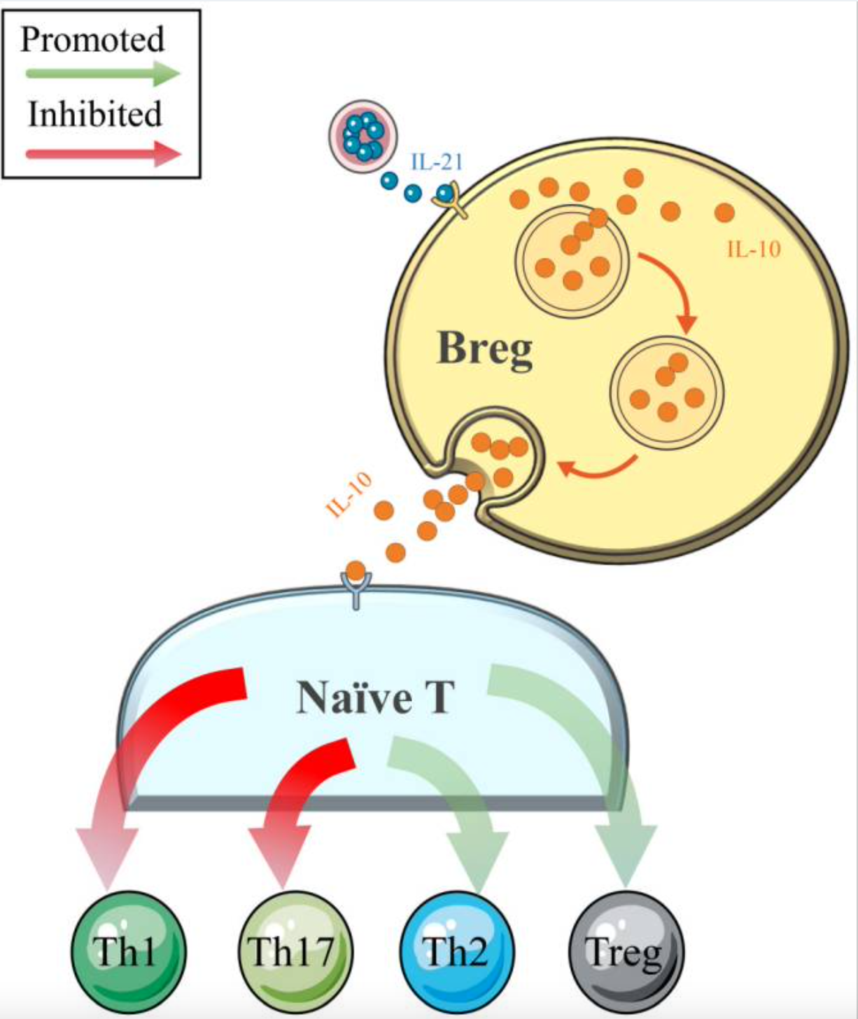
Miscarriage
In the healthy patients, CD19+CD24hiCD38hi Breg cells could inhibit naïve T cell differentiation into Th1 and Th17 cells and convert CD4+CD25- T cells into regulatory T cells (Tregs) by the production of IL-10.
For successful implantation and fetal development during pregnancy, the proportions of naïve CD4+ T-helper cell subsets, which are mainly differentiated into Th1 cells, Th2 cells, Th17 cells, and Treg cells, are significantly correlated with immune tolerance at the maternal-fetal interface
Treg(regulatory T cell), IL-21

Slide 33
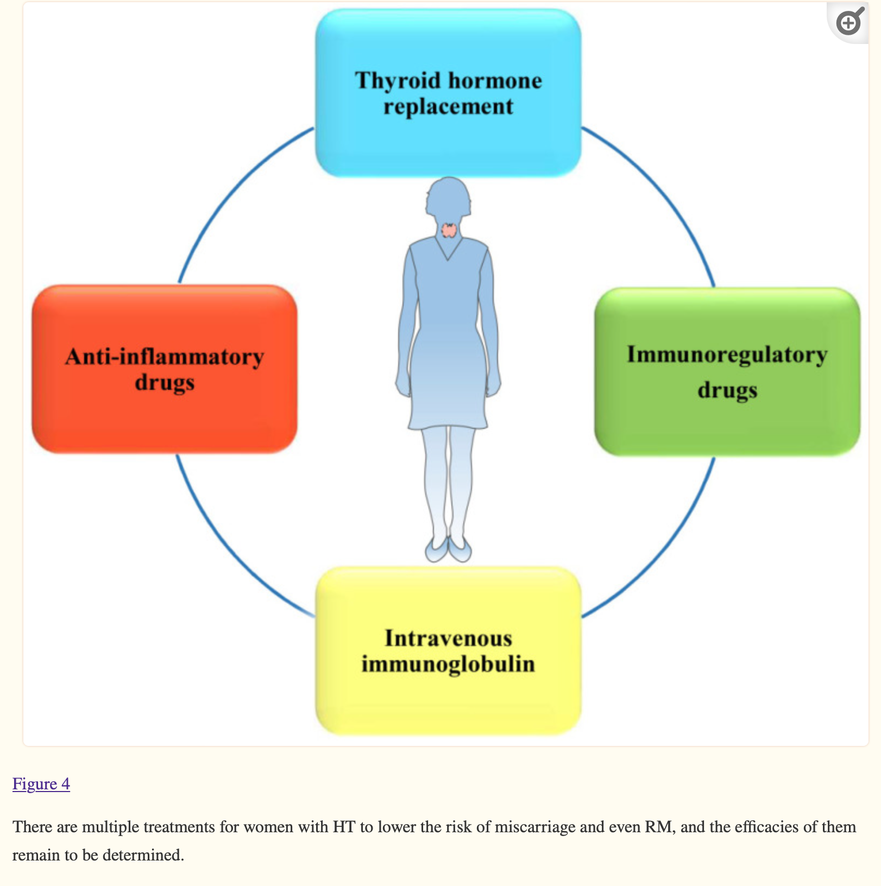
Treatments:
L-T4 supplementation, recommended by the American Thyroid Association (ATA): used to decrease the incidence of overt hypothyroidism during pregnancy among euthyroid women.
Immunoregulatory drugs;Selenium and vitamin D3: efficiently alleviate HT progression and regulate the immune system,

Slide 34
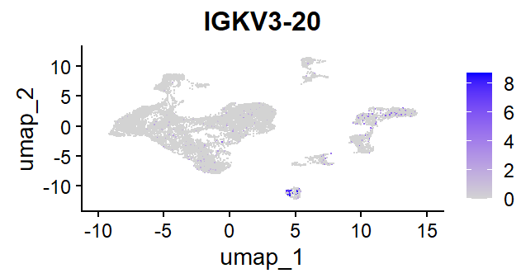

Slide 35
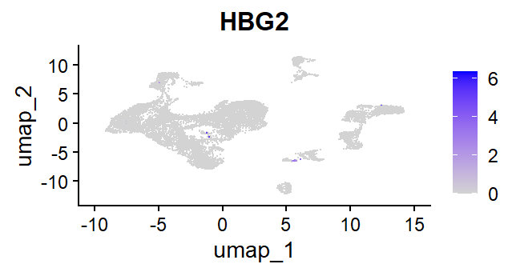

Slide 36
